Slide 1
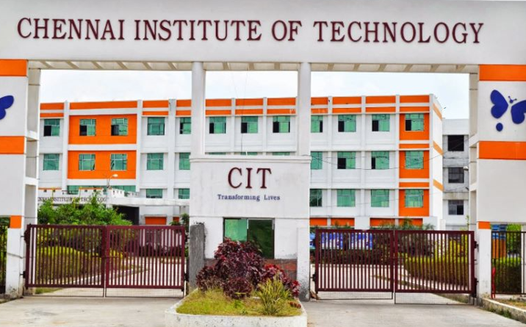
STUDENT SKILLSET SYSTEM
[ SSS ]
Developed By
T.B. Venkataraman – 2nd BE (CSE)
S. Yashwanth - 2nd BE (CSE)
CIT, Chennai

Slide 2
Introduction
This system aims to capture the personal information and skillset details (portfolio) of the students.
It is database of all details used for career development.
This SSS can be used in the Placement Cell
of our College to identify the candidates with right skillset.

Slide 3
Set up
Login
About Me
Skillset
Education
Curriculum Projects
Hobbies
Contact details

Slide 4
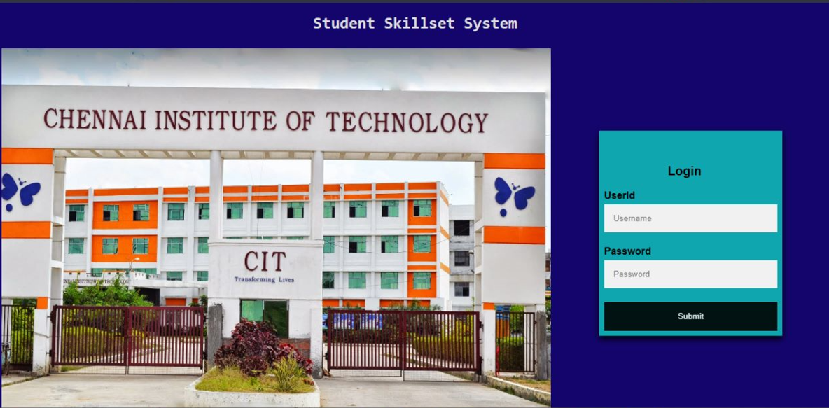
SSS – LOGIN

Slide 5
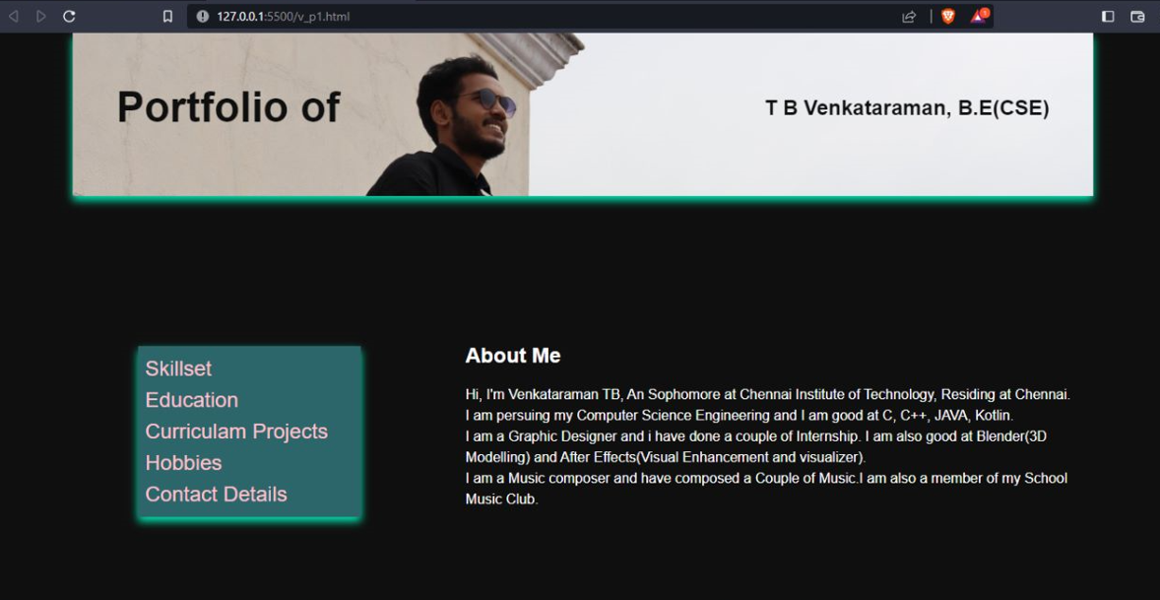
SSS – About Me

Slide 6
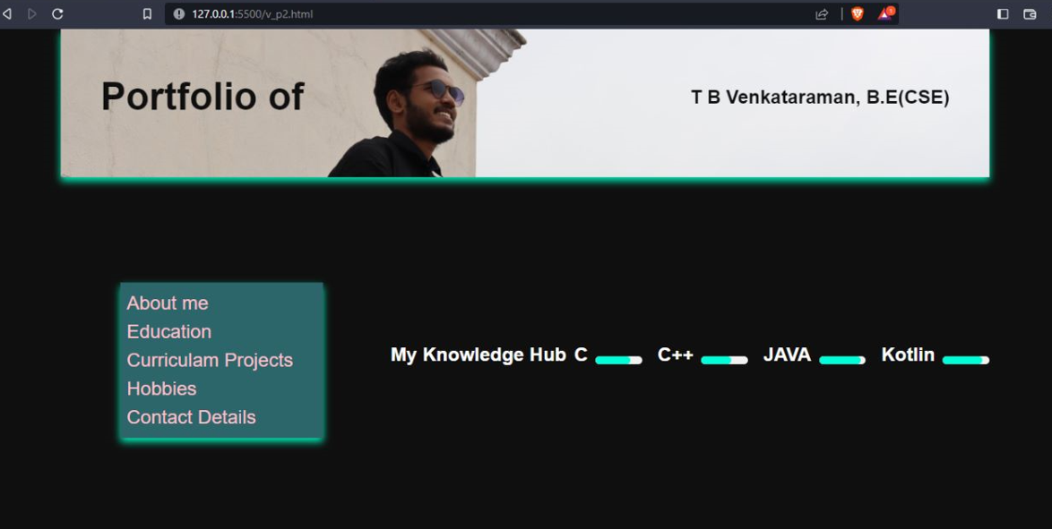
SSS – skillset

Slide 7
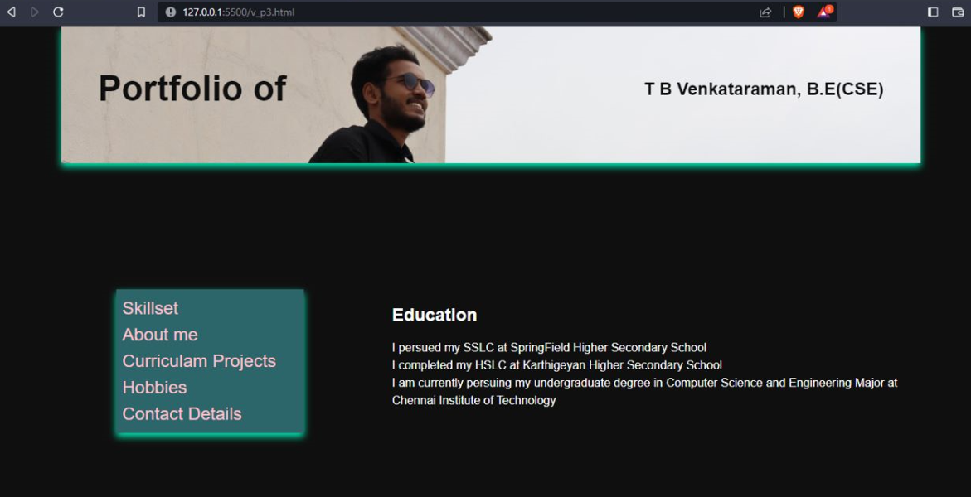
SSS – education

Slide 8
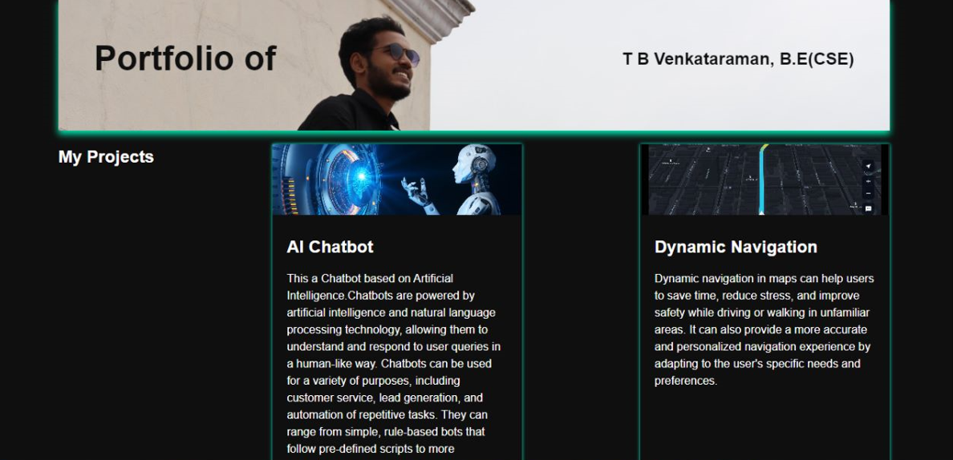
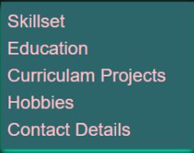
SSS – curriculum projects

Slide 9
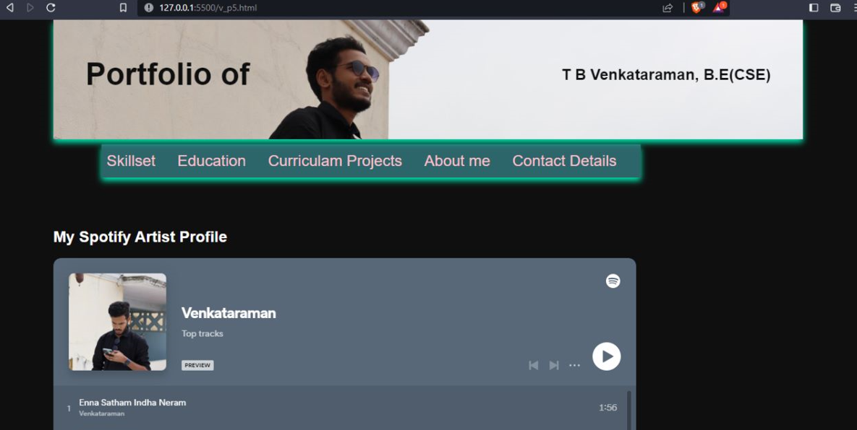
SSS – hobbies

Slide 10
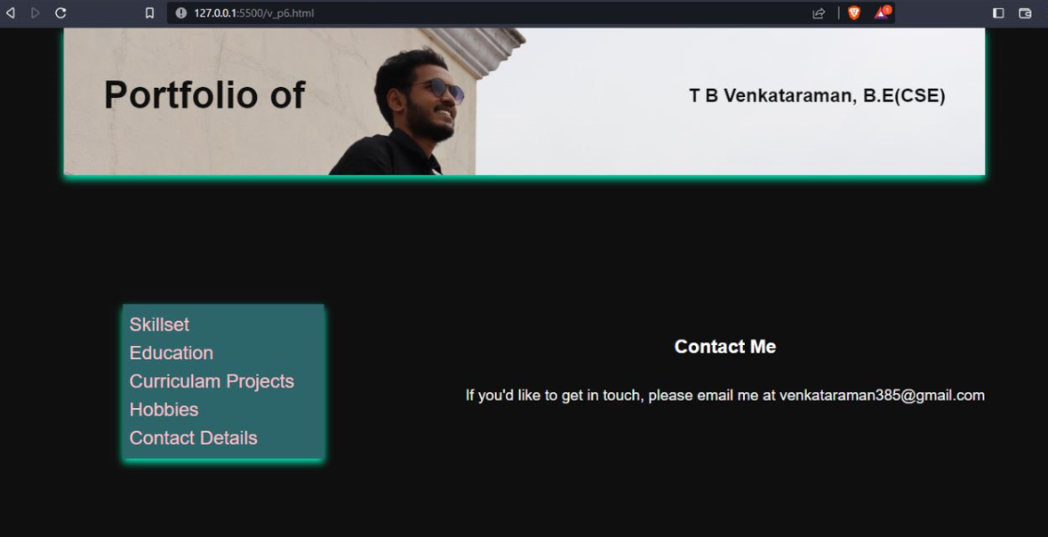
SSS – contact details

Slide 11


